Slide 1
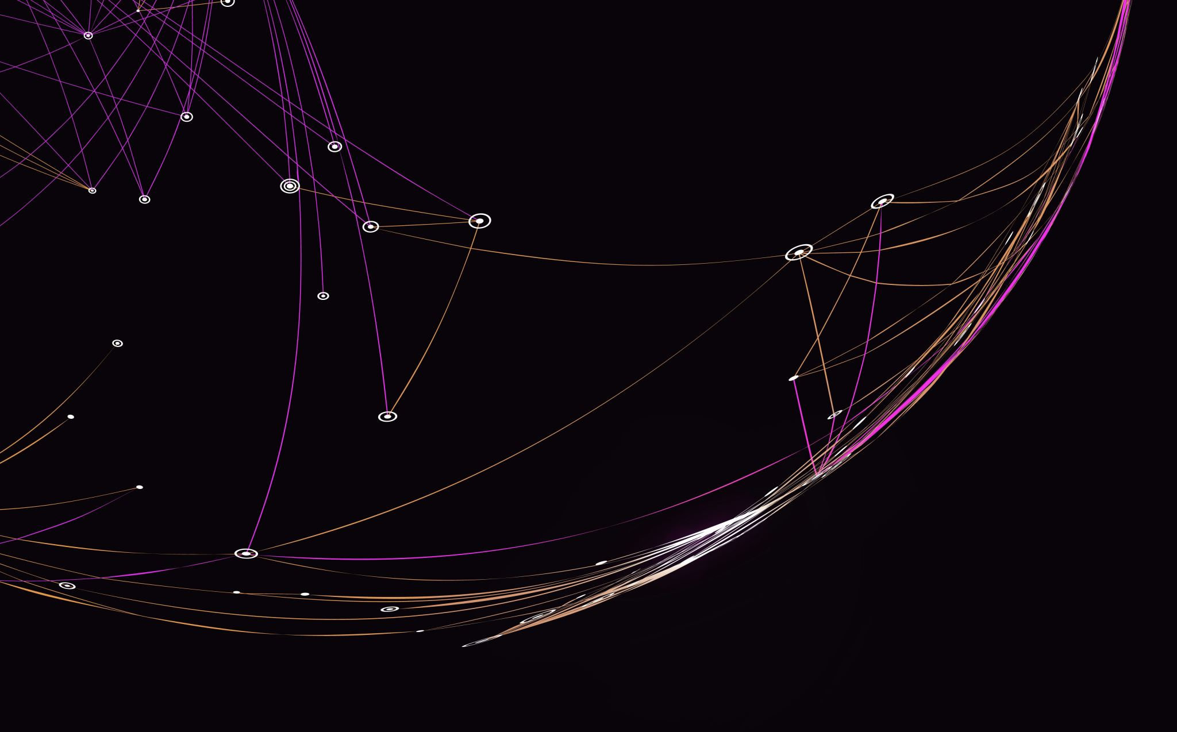
Weekly Report – Point Cloud Group
Wenhe Xu

Slide 2
Contents
RandLA
LFA
Attentive Pooling
Dilated Residual Block
Point-Voxel…
Point
Voxel
Point Voxel

Slide 3
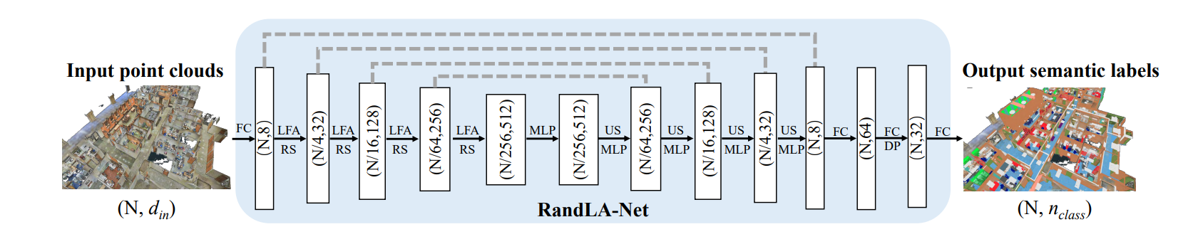
RandLA
Challenge
Downsampling Strategy: Existing algorithms either have high computational costs or consume a lot of memory. For instance, the widely-used farthest-point sampling takes over 200 seconds to downsample a point cloud of 1 million points to 10% of its original size.
Feature Learning: Many methods rely on computationally expensive processes like kernelization or graph construction.
Limited Receptive Fields: Most existing methods have limited receptive fields, making it difficult to efficiently and accurately capture complex geometric structures in large-scale point clouds.
Goal
Lightweight, computationally-efficient, and memory-efficient network
Directly handle large-scale 3D point clouds without voxelization, block partition, or graph construction.
Notes:
Background:
The paper addresses the need for efficient and accurate semantic segmentation of large-scale 3D point clouds in real-time autonomous driving systems. Traditional convolutional neural networks are not directly applicable to this kind of data, which is often irregular, unstructured, and orderless. Since the introduction of PointNet in 2017, which can directly extract features from point clouds, various methods have been proposed to handle irregular point clouds. While these methods perform well in small-scale scenarios, they face challenges in large-scale environments.

Slide 4
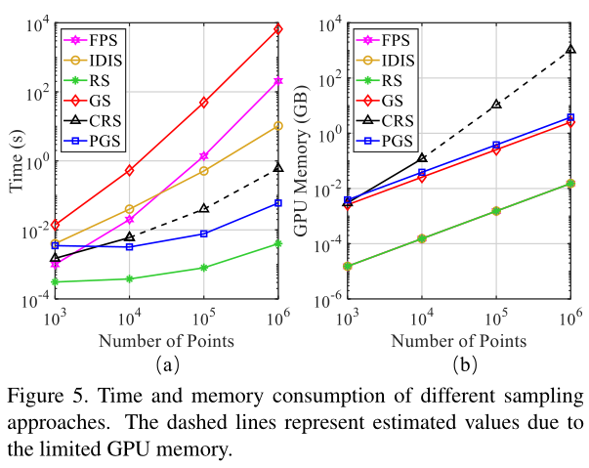
RandLA - Downsampling
Not only significantly reduces the memory footprint of the model, but also allows the model to extract structural features of the point cloud at different scales.
Existing Downsampling Methods, including:
Heuristic sampling methods Farthest point sampling (FPS)
Inverse Density Importance Sampling (IDIS)
Random sampling (RS)
Learning-based sampling methods Generator-based Sampling (GS)
Continuous Relaxation based Sampling (CRS)
Policy Gradient based Sampling (PGS).
Notes:
It can be seen that the computational cost of FPS, IDIS, and GS is high in large field attraction clouds, and CRS has a high memory footprint. In addition to this, PGS is unable to learn an effective sampling strategy due to the large search space, therefore, this paper uses random sampling to sample the large field attraction cloud from the computational efficiency. However, some useful information may be lost in random sampling, for this reason, this article proposes a Local Feature Aggregation (LFA) module to compensate for the information loss due to sampling.

Slide 5
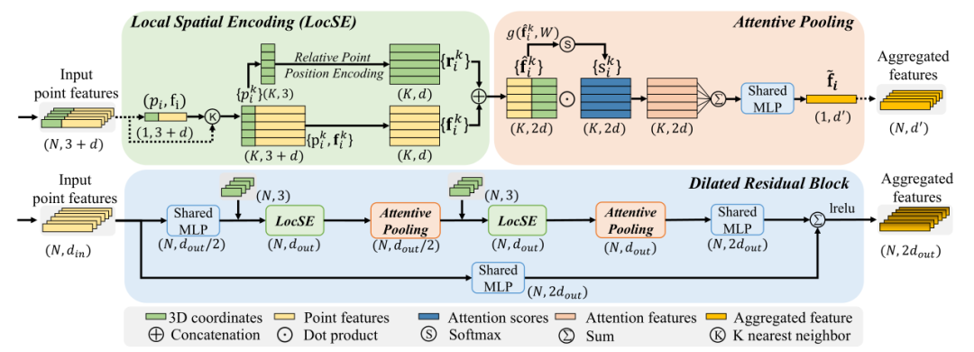
RandLA – LFA

Slide 6

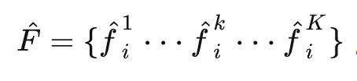

RandLA - LocSE
1. Finding Neighbouring Points (KNN): for the i-th point, which has coordinates p_i and feature f_i, use KNN to find this point. , use KNN to find K neighbors of this point {}, the feature of each neighbor point is:
2. Relative Point Position Encoding (RPPE): For each neighbor point p^k_i of p_i, put together a bunch of information (center point coordinates, neighbor point coordinates, coordinate difference, distance from the center point to the neighbor point), and process it with an MLP to get a new feature:
3. Neighbor Point Feature Augmentation (Point Feature Augmentation): the original feature f^k_i of each neighbor point and the feature r^k_i after Relative Point Position Encoding are spliced together to form a new feature
inside the feature of each neighbor point, the position information with respect to the center point is added.
Notes:
It can be seen that the computational cost of FPS, IDIS, and GS is high in large field attraction clouds, and CRS has a high memory footprint. In addition to this, PGS is unable to learn an effective sampling strategy due to the large search space, therefore, this paper uses random sampling to sample the large field attraction cloud from the computational efficiency. However, some useful information may be lost in random sampling, for this reason, this article proposes a Local Feature Aggregation (LFA) module to compensate for the information loss due to sampling.

Slide 7

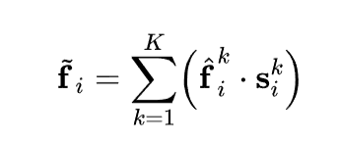
RandLA – Attentive Pooling
This module is used to aggregate the features generated by the local spatial coding module. This module uses the ATTENTION mechanism to feed the point features into the MLP and softmax layers to get the ATTENTION score.
Neighborhood point features are weighted and summed using ATTENTION SCORE to get a new centroid feature.

Slide 8
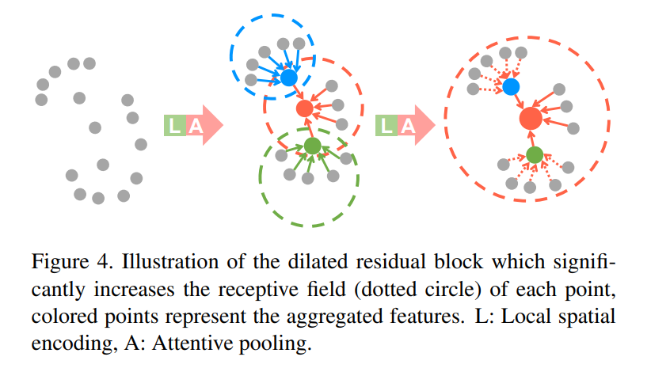
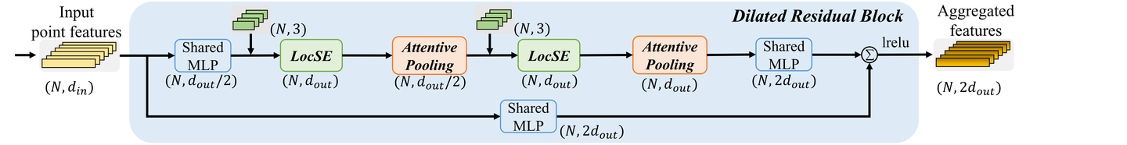
RandLA – DRB (Dilated Residual Block)
The main idea of this module is to compensate for the loss of information due to random sampling by expanding the receptive field of each point. In this module, two sets of local spatial coding and attentive pooling modules are used to make the receptive field of each point increase from its k nearest neighbors to up to k^2 points.

Slide 9
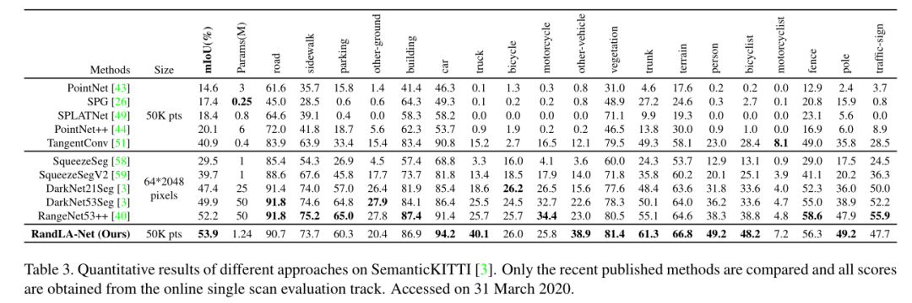
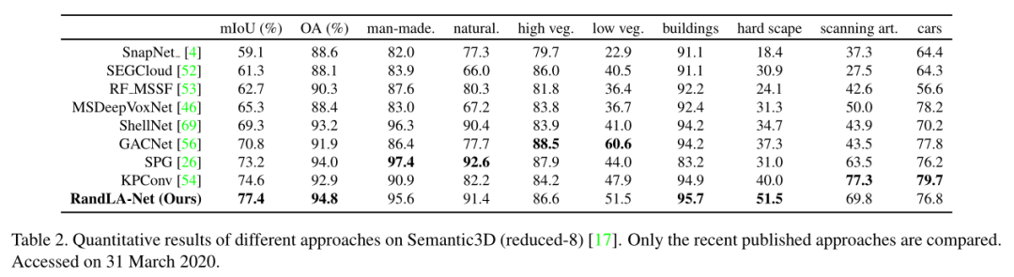
RandLA –Result: SotA (2020)
SemanticKITTI
Semantic3D
Notes:
The runtime of RandLA-Net is compared with other models in SemanticKitti's validation set. It can be seen that RandLA-Net is much smaller than the other models in terms of computation time and can handle larger point clouds simultaneously.

Slide 10
Appendices of RandLA

Slide 11
Point-Voxel
Refer to my note on GitHub
Notes8813/Voxel-point at main · LiliumJadez/Notes8813 (github.com)

